Slide 1
Applications of Data Science
Subtitle: Case Studies And Examples Across Industries
Presented by: Femi George
Data Science Course
27th August, 2024

Slide 2

Introduction
What is Data Science?
Interdisciplinary field using scientific methods, algorithms, and systems to extract knowledge from data.
Importance of Data Science drives decision-making, enhances efficiency, and fosters innovation across various sectors.

Slide 3
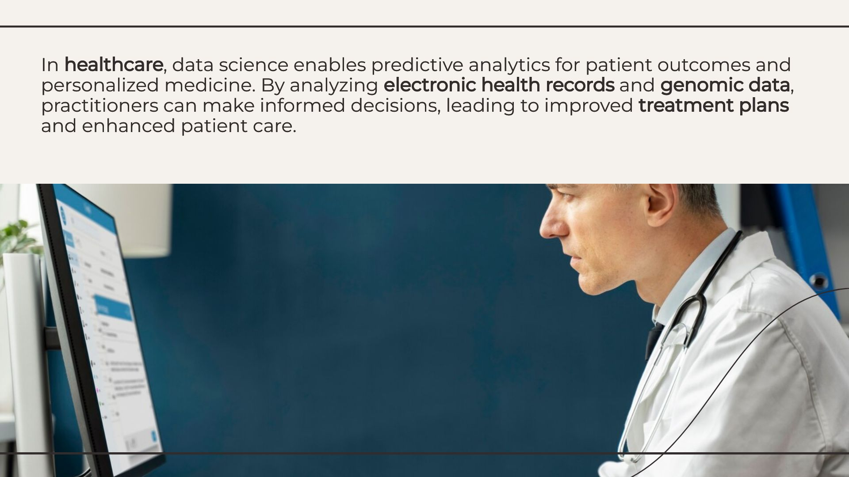
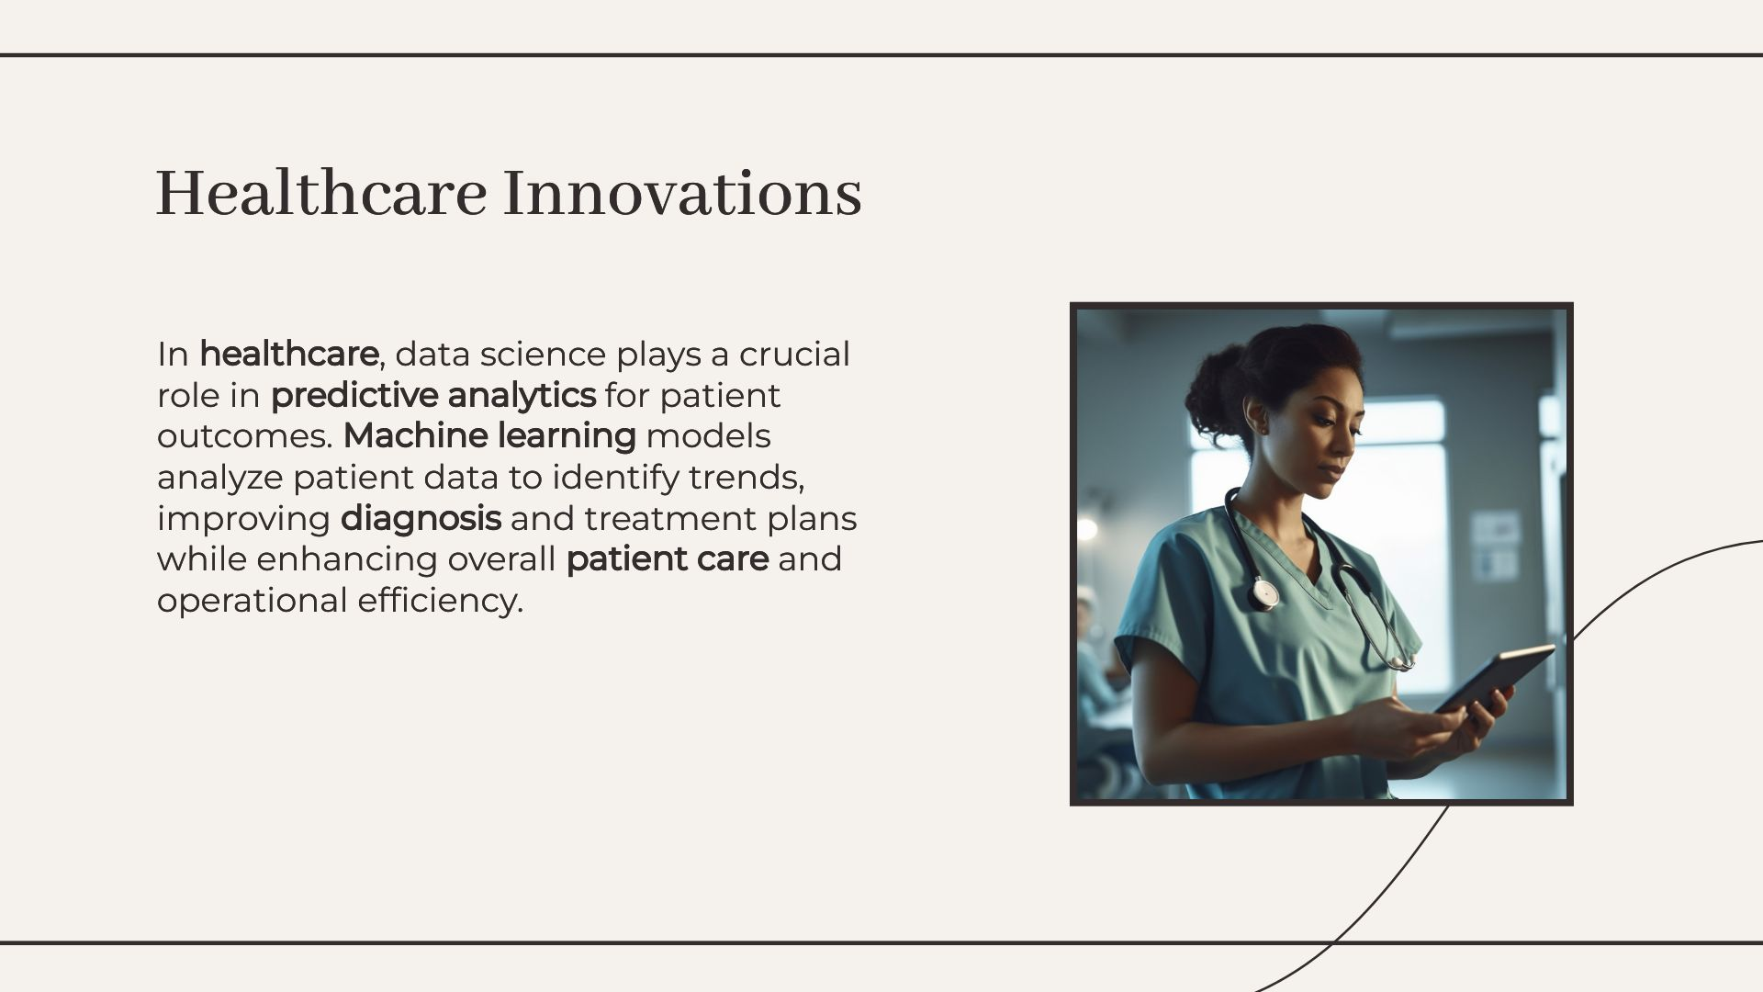
In Health Care

Slide 4
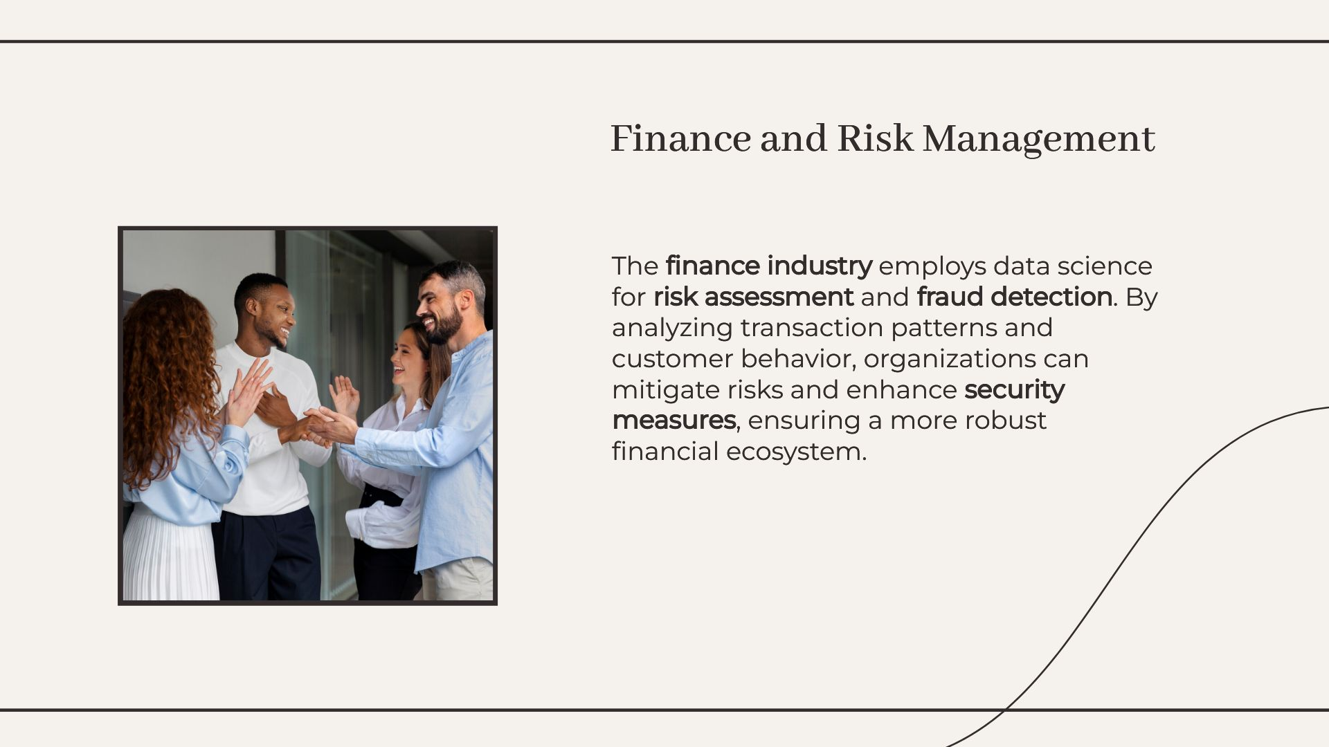
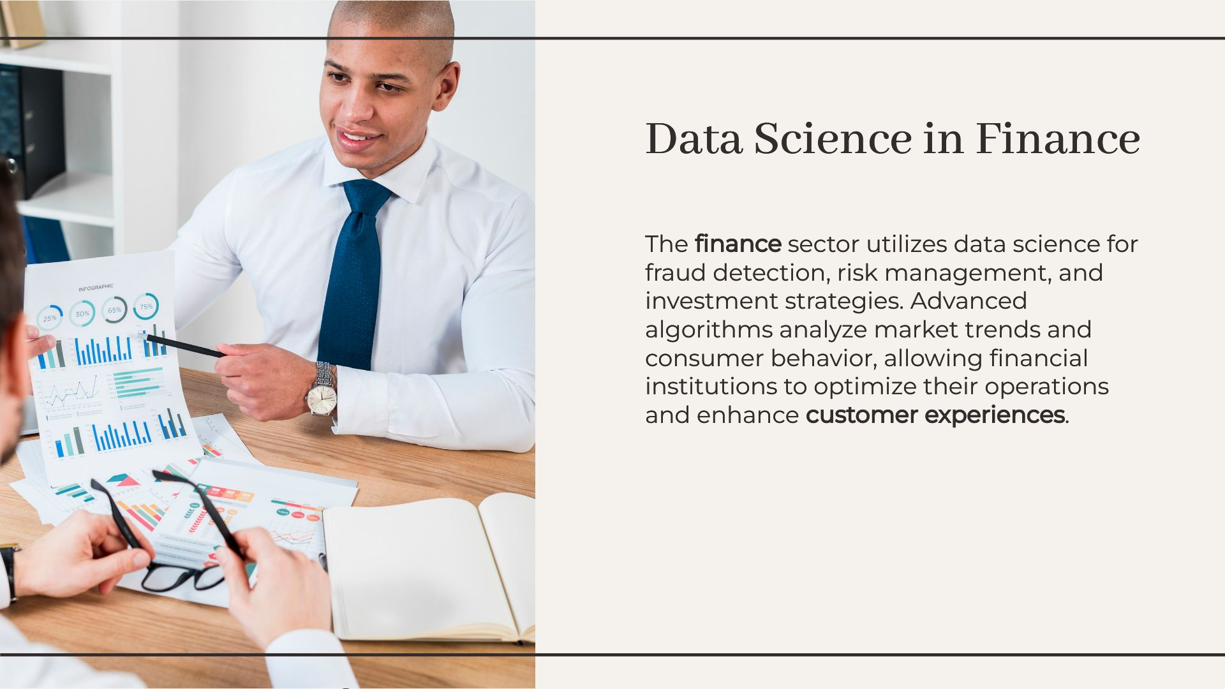
Data Science In Financial And Risk Management
Advanced algorithms analyze market trends and consumer behaviour, allowing financial institutions to optimize their operations and enhance “Customer experiences”
Financial institutions use algorithms to detect fraudulent transactions in real-time.

Slide 5
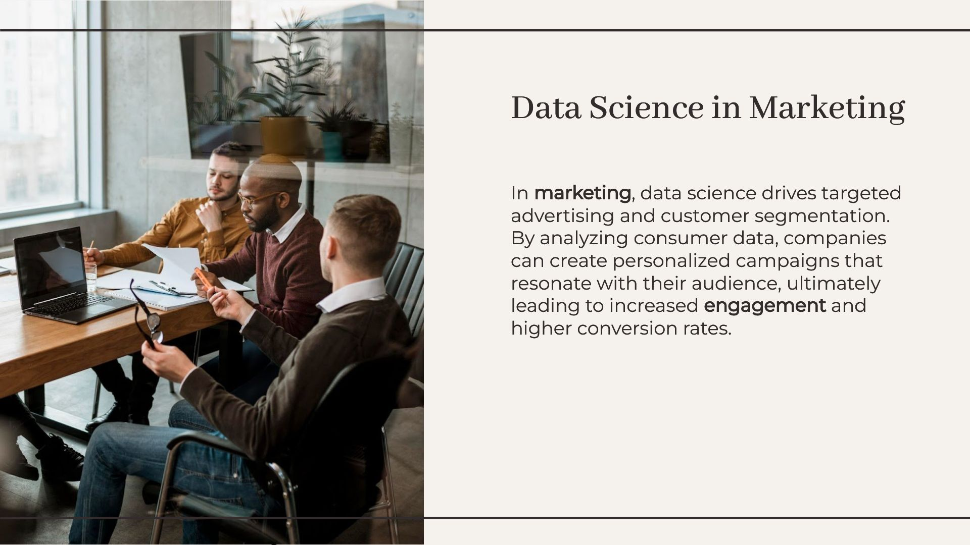
Data Science In Marketing
Customer Segmentation
Companies analyze customer data to create targeted marketing strategies.
Predictive Analytics for Campaigns
Data science predicts campaign success, optimizing marketing spend.

Slide 6
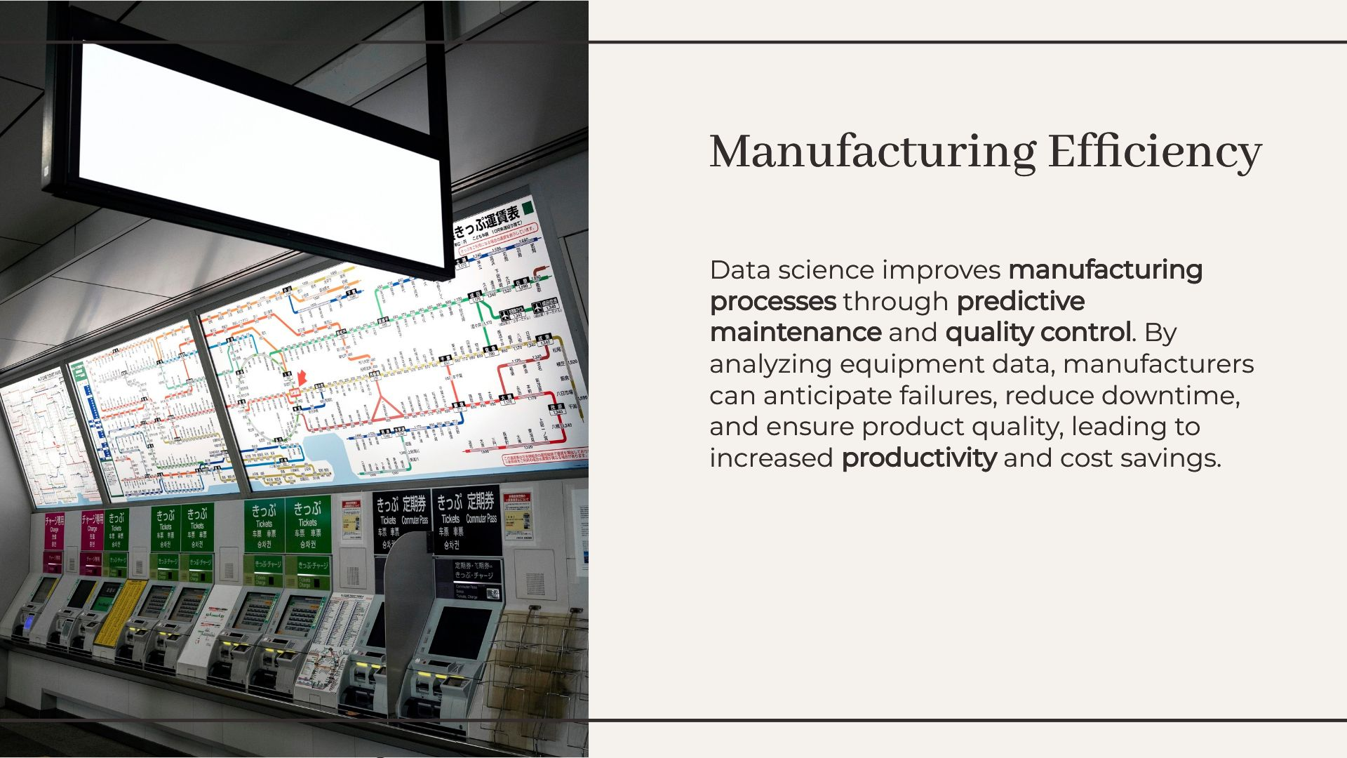
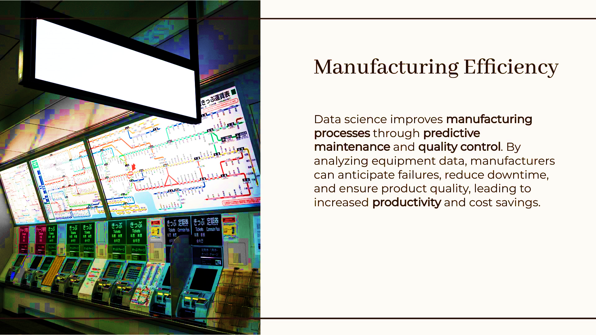
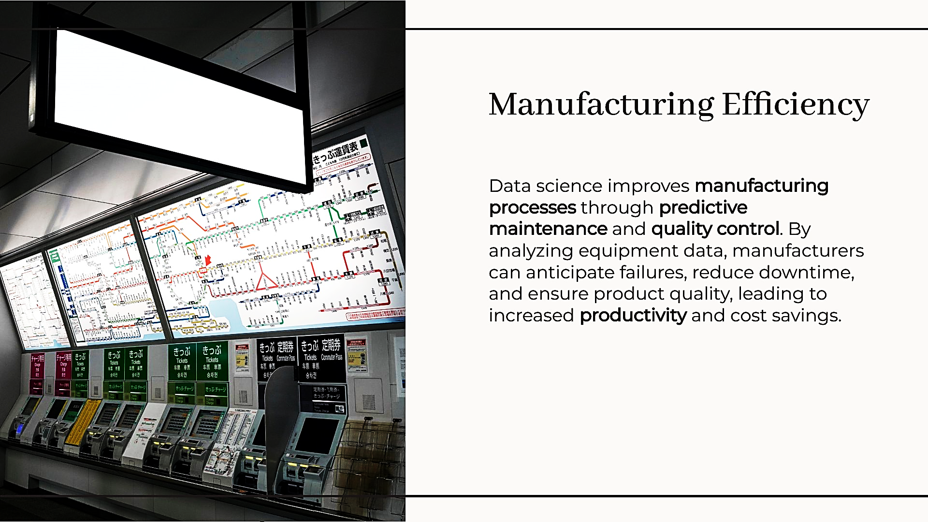
Manufacturing Efficiency

Slide 7
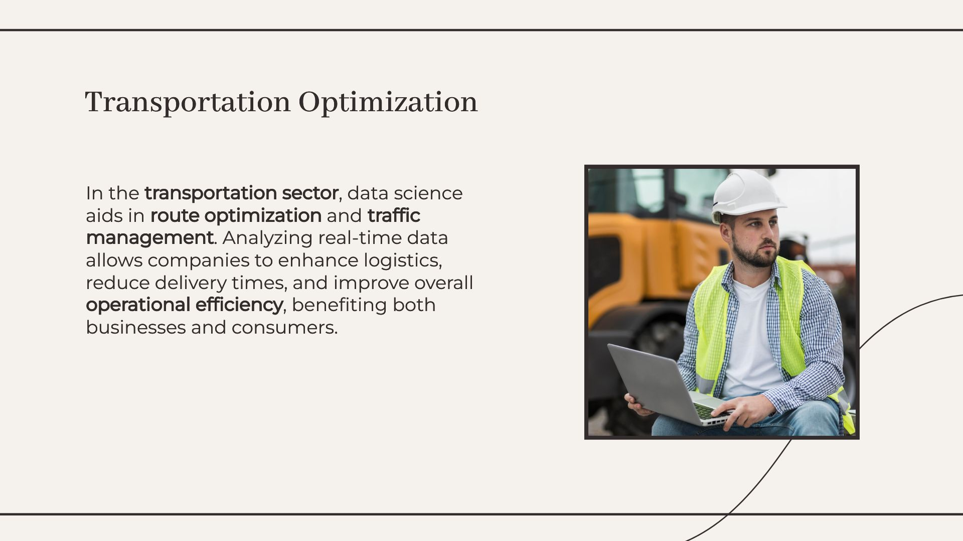
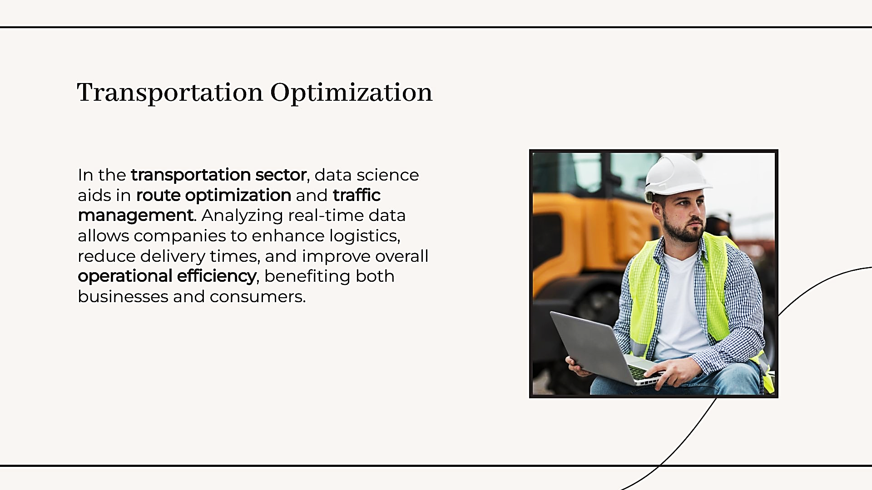
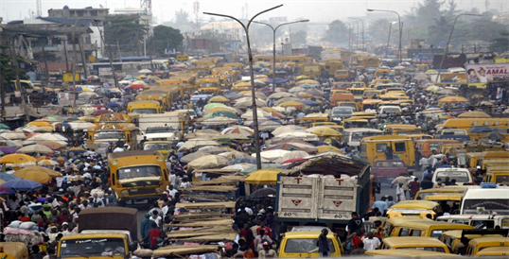
This Photo by Unknown Author is licensed under CC BY

Slide 8
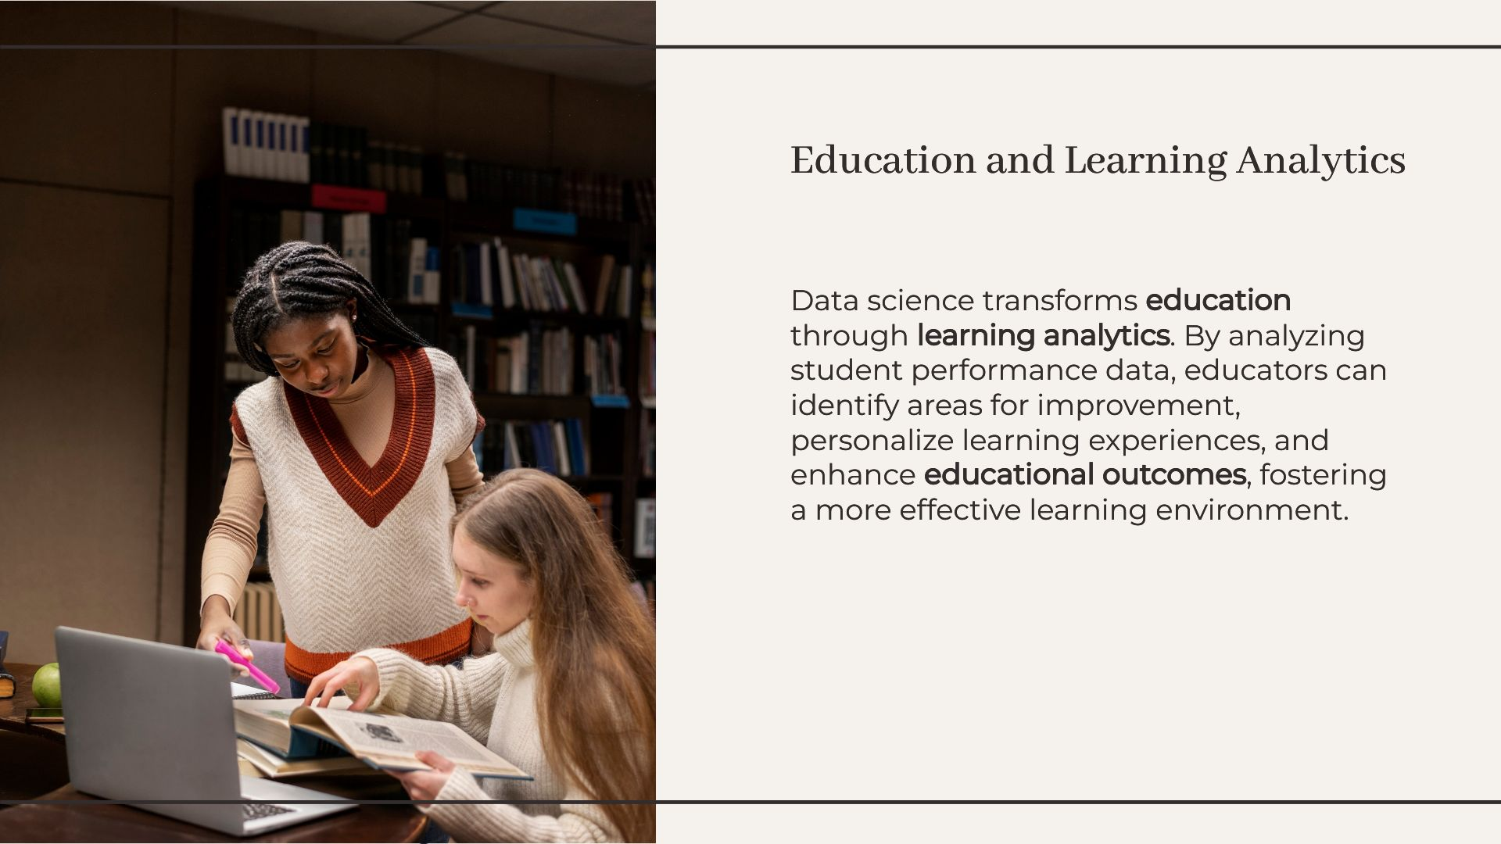
Education and Learning Analytics

Slide 9
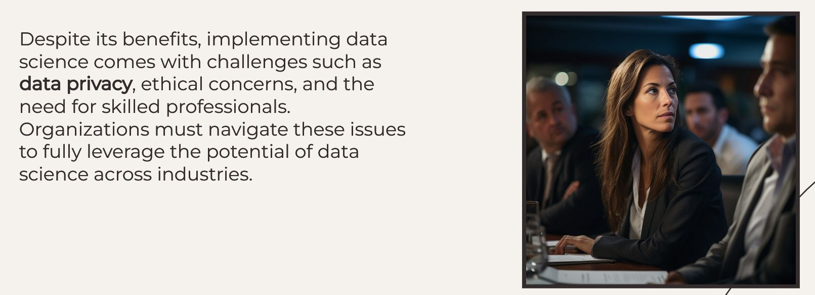
Challenges And Consideration

Slide 10
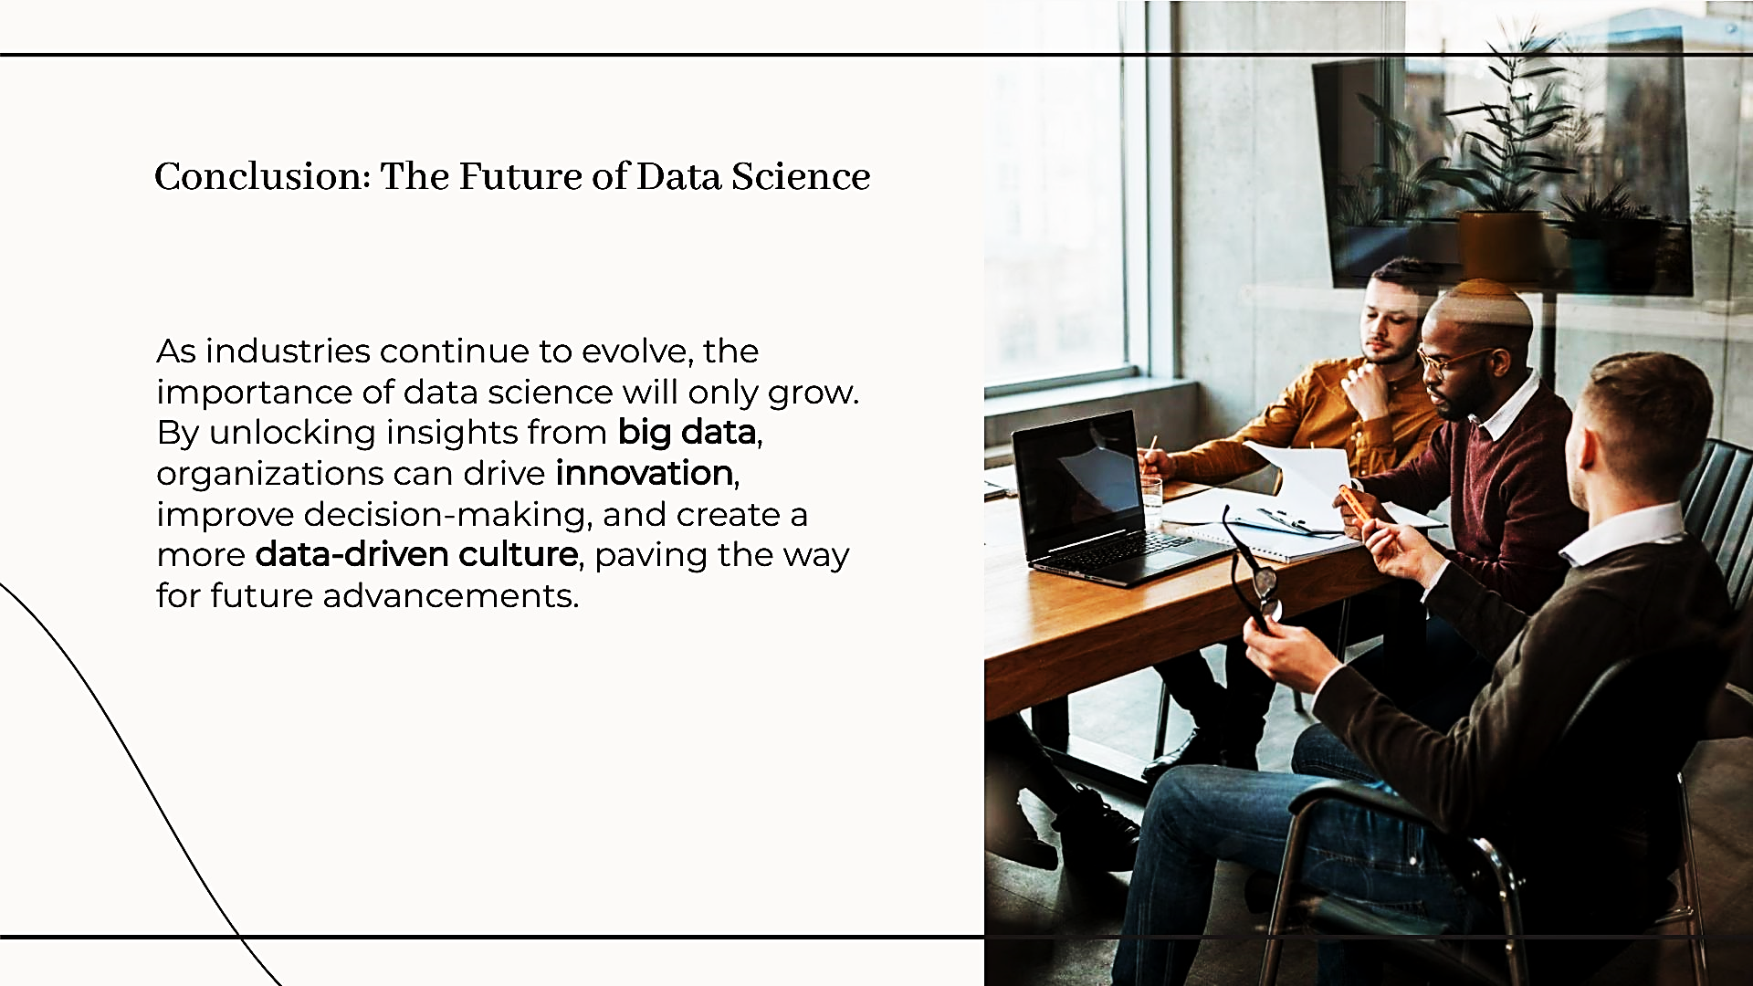
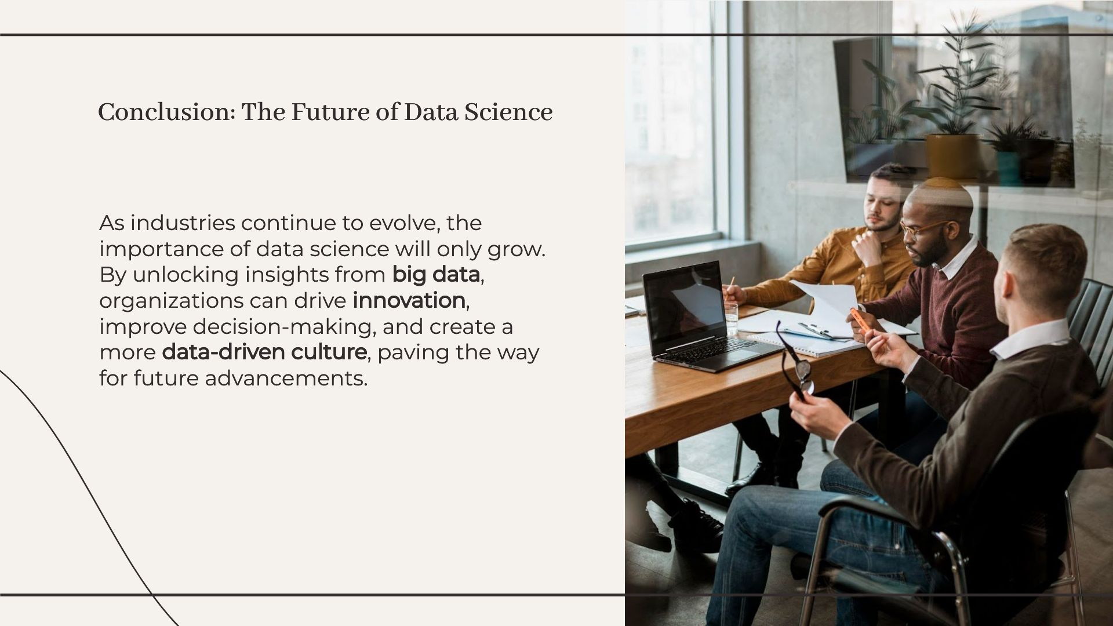
Conclusion: The Future of Data Science

Slide 11
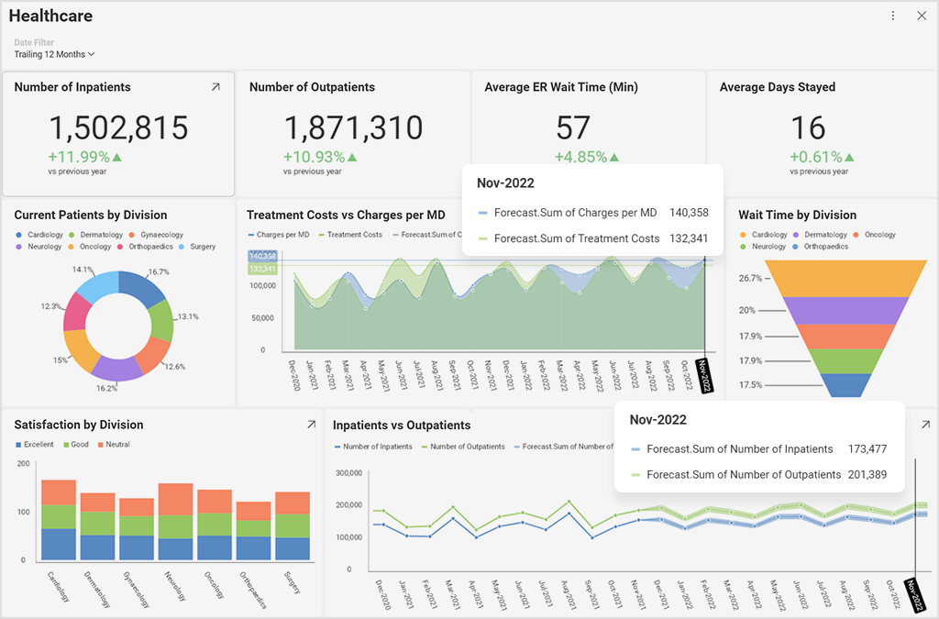
Predictive Analytics In Healthcare

Slide 12
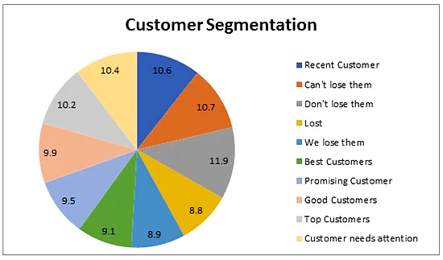
Customer Segment

Slide 13
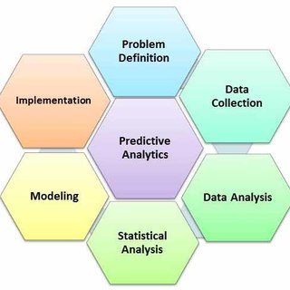
Predictive Analytics Process
Predictive Analytics Process In Health Care

Slide 14
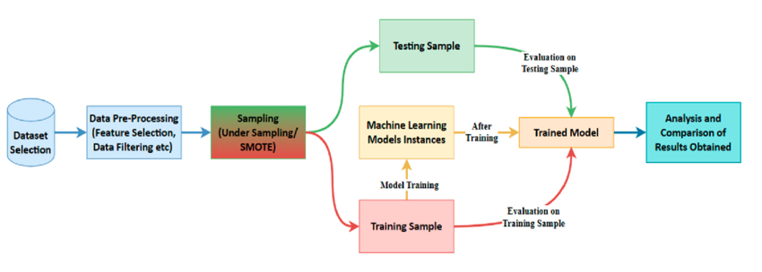
Flow Diagram of Credit card Fraud Detection

Slide 15
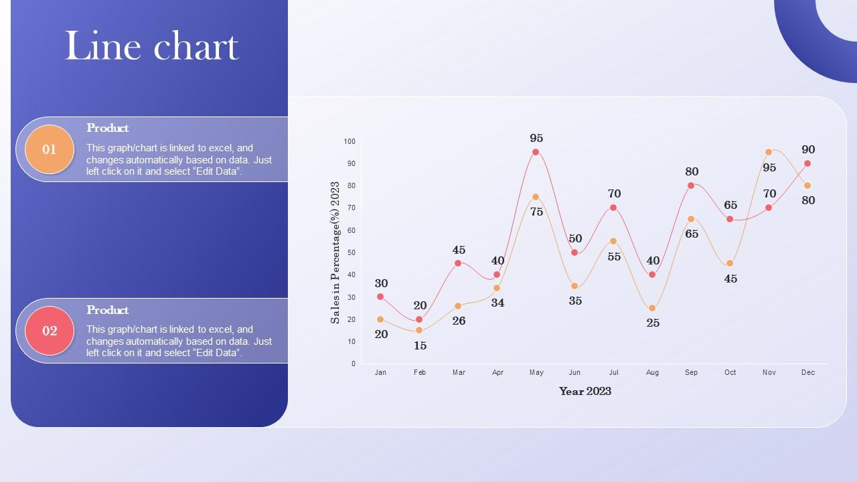
Line Chart Data Driven Marketing Guide To Enhance_roi

Slide 16
References
Mount Sinai Health System. (2018). "Predictive Analytics in Healthcare."
Google DeepMind. (2020). "AI for Medical Imaging."
Atomwise. (2021). "AI for Drug Discovery."
PayPal. (2019). "Fraud Detection with Machine Learning."
ZestFinance. (2020). "Alternative Data for Credit Scoring."
Renaissance Technologies. (2021). "Algorithmic Trading Strategies."
Netflix. (2019). "Personalized Recommendations."
Coca-Cola. (2020). "Sentiment Analysis in Marketing."
Amazon. (2021). "A/B Testing for E-commerce Optimization."

